Slide 1
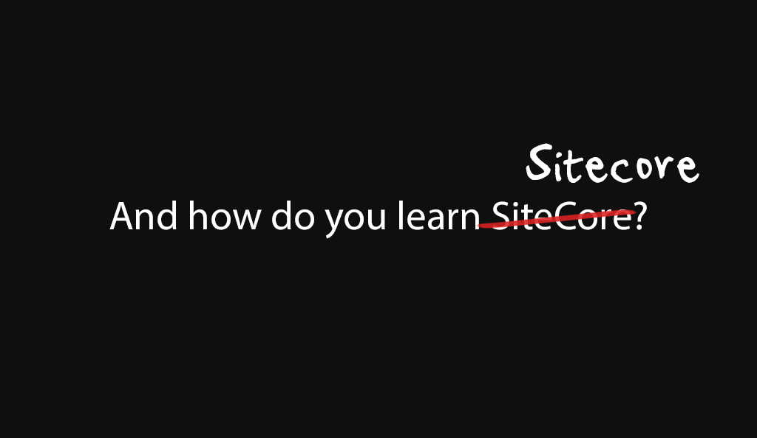

Slide 2
What do we have?

Slide 3
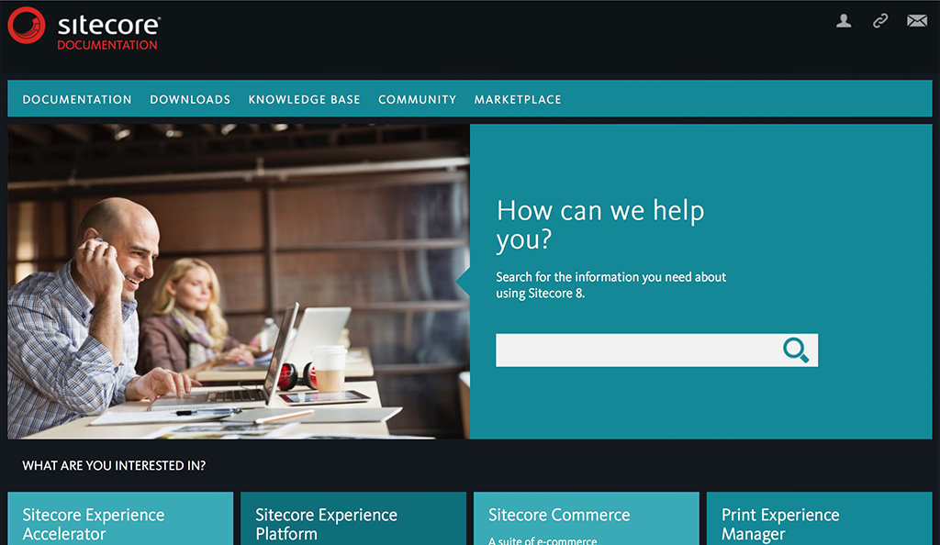
Official Sitecore Documentation
doc.sitecore.net

Slide 4
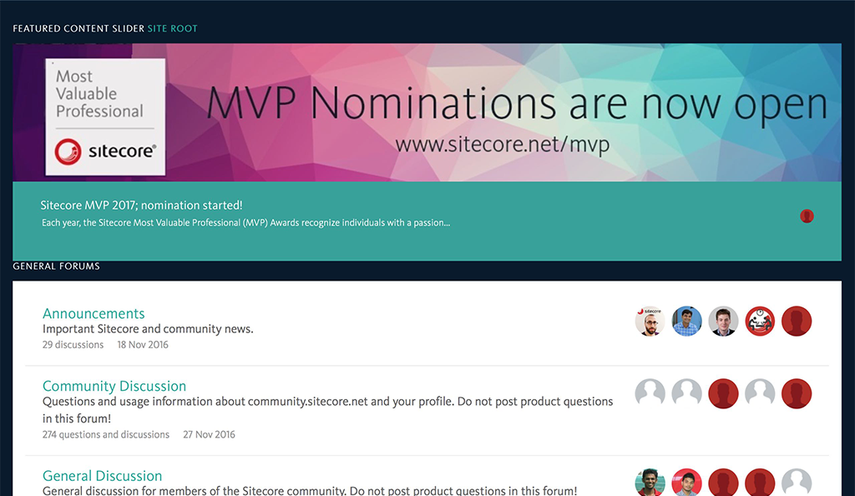
Sitecore Community Portal
community.sitecore.net

Slide 5
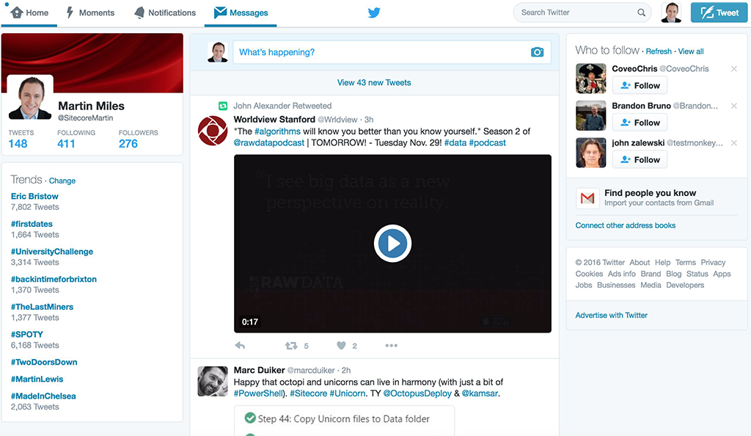
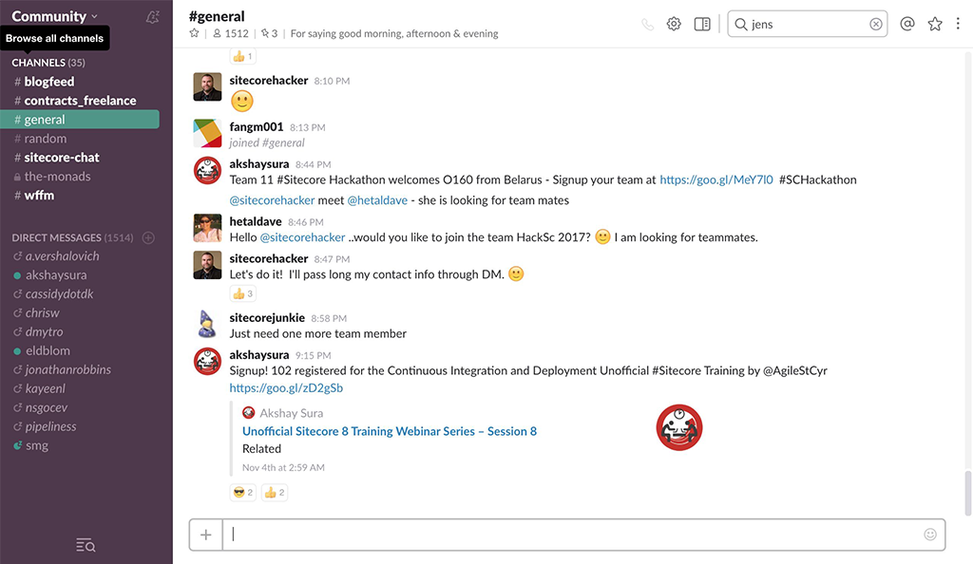
Communication channels - Twitter and Slack
https://twitter.com/
https://sitecorechat.slack.com/

Slide 6
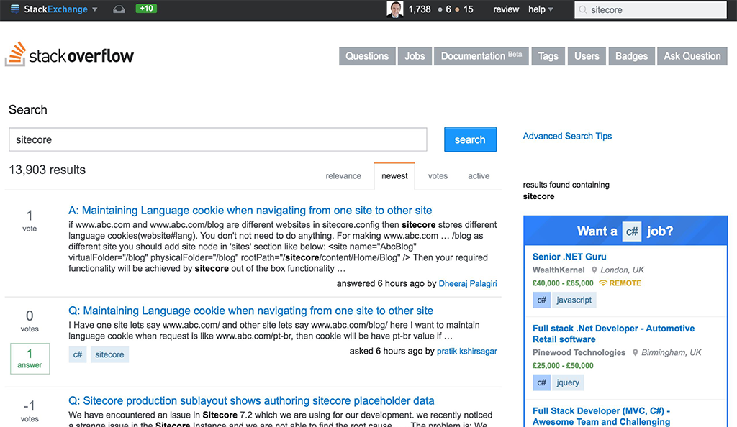
StackOverflow
stackoverflow.com/search?q=sitecore

Slide 7
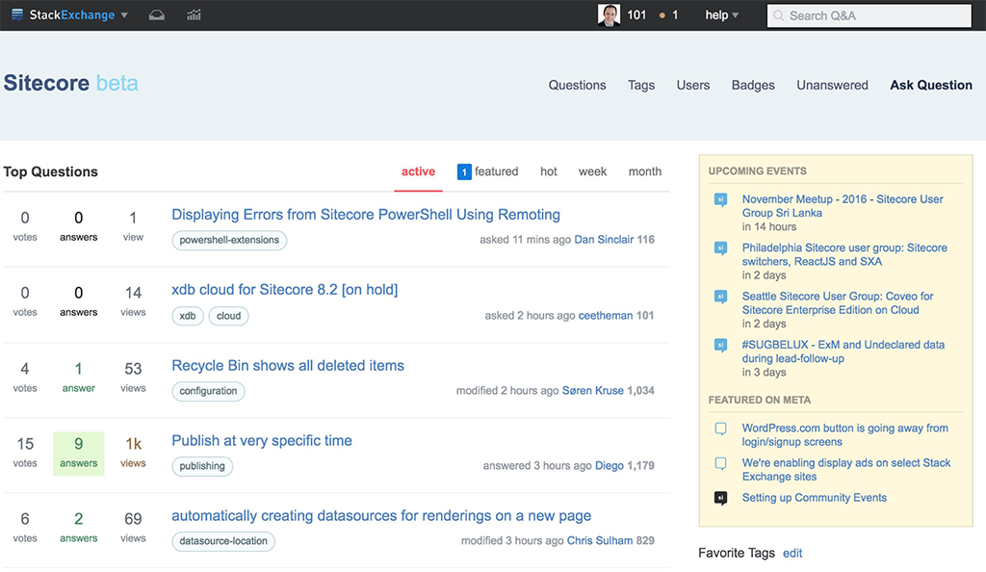
Sitecore Stack Exchange
http://sitecore.stackexchange.com/

Slide 8
.. and of course, blog and you-tube channels

Slide 9
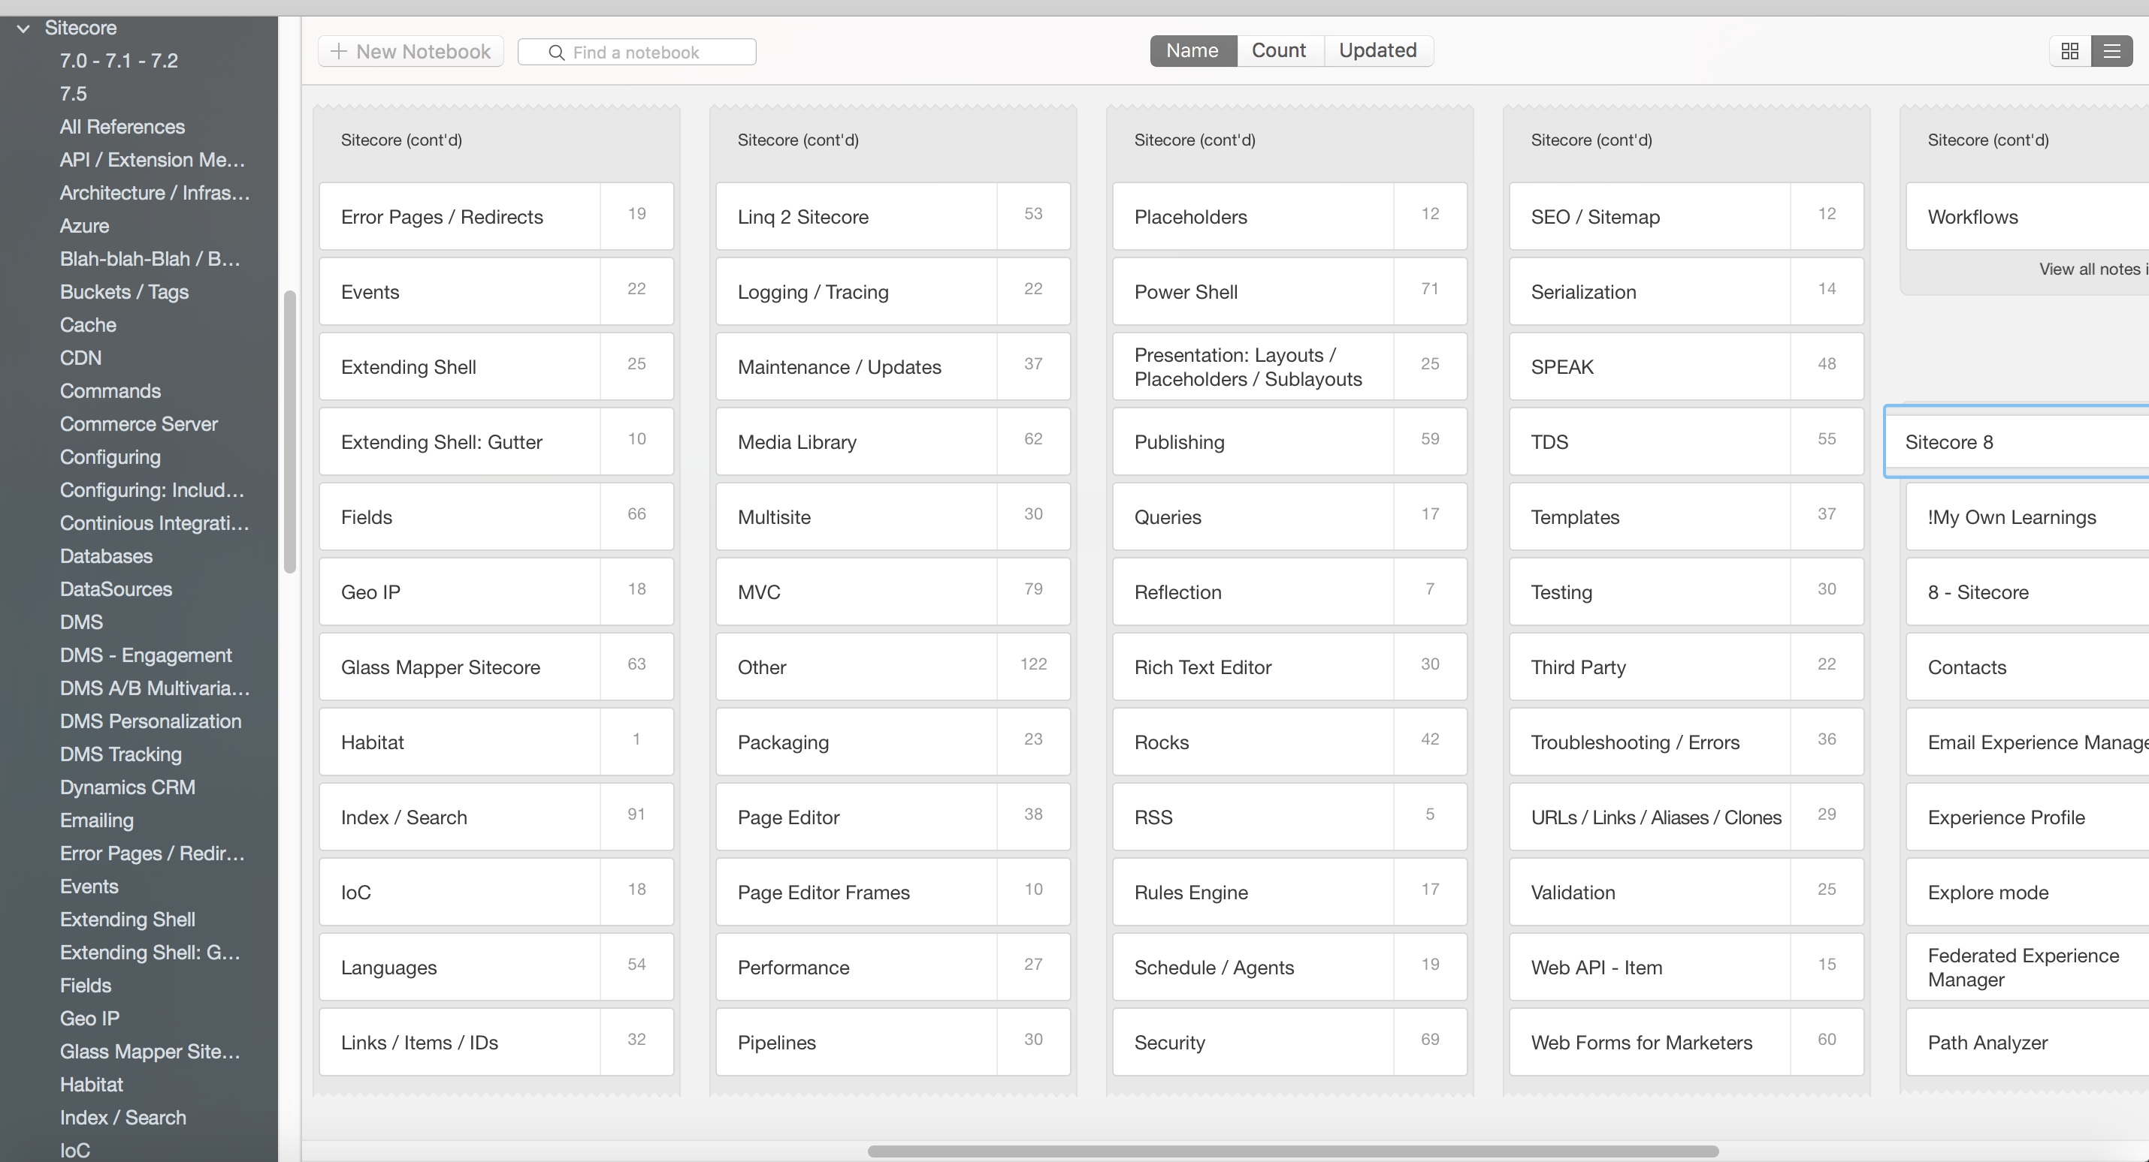
Evernote made me crazy …

Slide 10
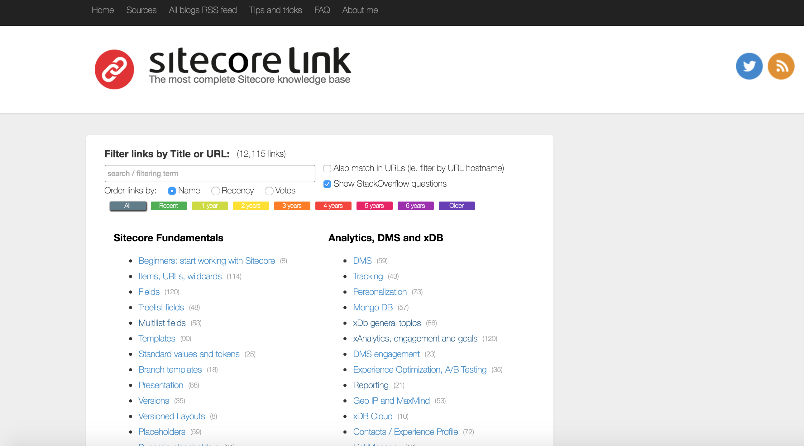
Finally.. Sitecore Link
Sitecore.Link

Slide 11
Future plans?
More precise classification
Total re-think and re-design the application
Implement intelligent search by content
Community governance
Analytics and trends

Slide 12
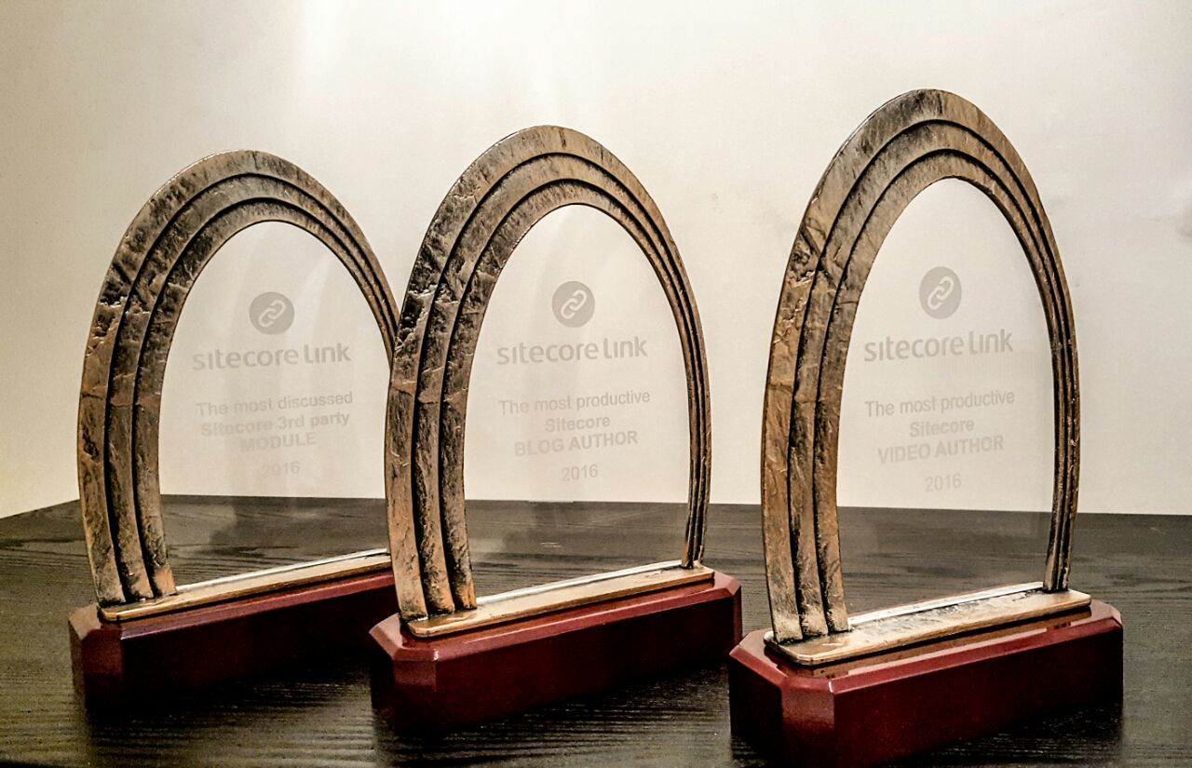
The most productive Sitecore blog author
The most productive Sitecore video author
The most discussed Sitecore 3rd party module

